Slide 1


Based Accident Detection and Alert System
Project Guide Project Coordinators Head Of The Department
Mr. Shankar Shastri Mr. Santoshkumar M Dr. Sanjay Pande M B
Project Team
GAGAN P SHYAGALE 4GM17CS011
MALLIKARJUN GBR 4GM18CS029
VIJAY KUMAR B R 4GM18CS060
YASHAS R 4GM18CS064

Slide 2
Contents :
Introduction
Objectives
Design of the project
Code implementation
Software requirements specification
Practical Result
Future work

Slide 3
Introduction :
This work is to construct a system that detects road accidents and pass the information to the concerned for medical treatment.
With help of sensor we will sense accident occurred or not, soon the location of the place will be shared to the nearby hospital.

Slide 4
Problem Statement:
We have observed that in many severe accident cases immediate help is not sent which leads to death of victims; in some cases, the family members of victims are informed after a long period of time; and in some rare cases the identity of victims remains unknown. Timely help and treatment could save life of victims, hence it is required to develop an automated system which not only detects accidents but effectively transfers the information to concerned authorities to take needful action.

Slide 5
Objectives :
To save life of victims by providing timely service.
To develop an automated system which plays key role in detecting and alerting accidents
To store accident information to centralized database.
To develop a prototype which consumes less power.

Slide 6
Design of the project :
Data Flow Diagram:
1. Fetch info from sensor
2. Check the threshold values &transmit via Lora
Info packet
Lora Transmitter
3. Receive data from Transmiter,Establish connection with server using Wi-Fi
Info packet
Lora Reveiver
4. Upload to database using PHP script
Alert message
5. Alert Concerned authority
Hospital

Slide 7
Activity Diagram of LoRa Transmitter:
Transmitter
Fetch info from Tilt sensor
Process the data
Send information to receiver

Slide 8
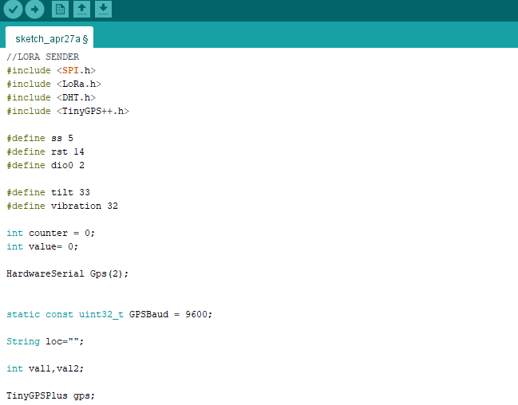
Code Implementation :

Slide 9
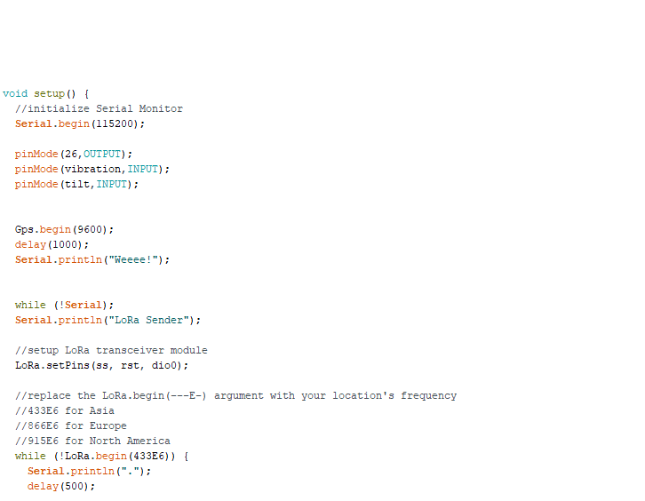

Slide 10
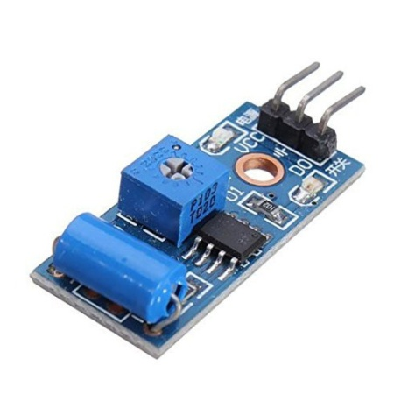
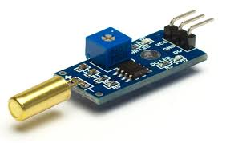
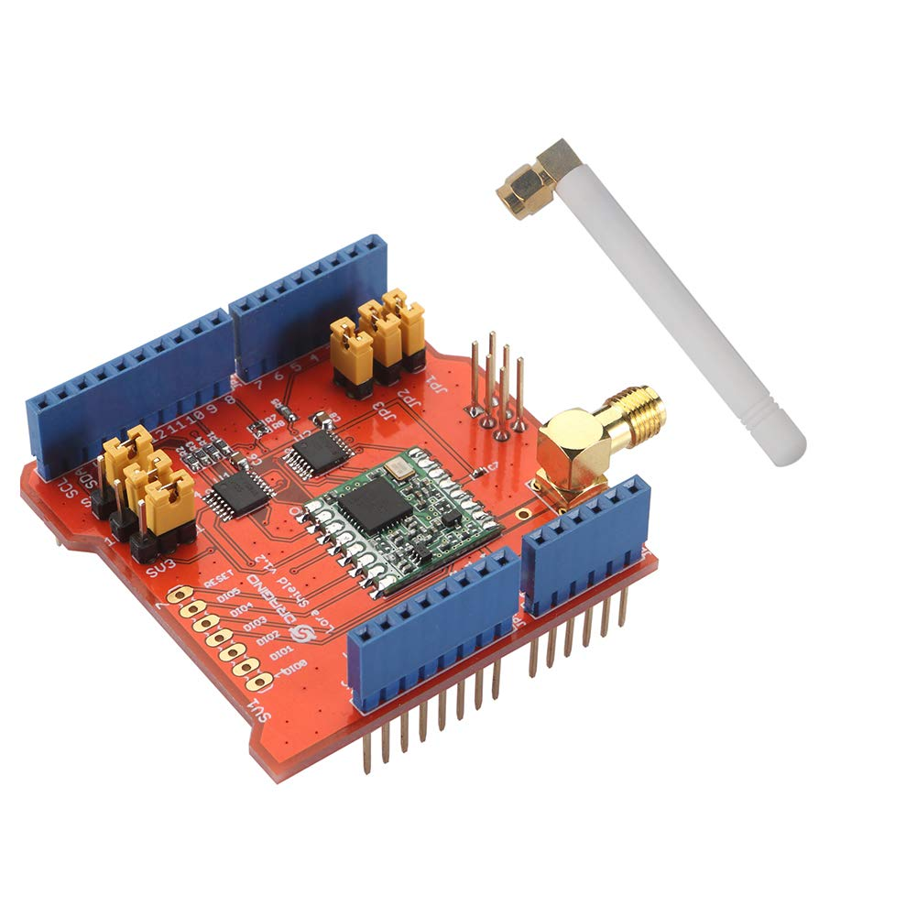
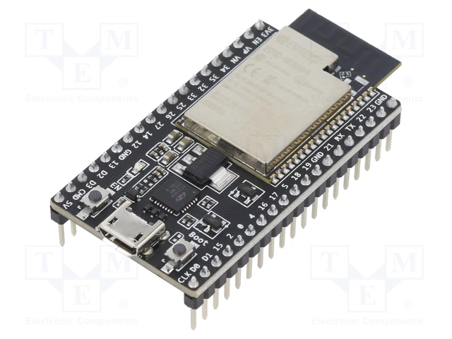
Software and Hardware Requirements :
Hardware Specification
Tilt Sensor 2. Vibration Sensor
3. LoRa Module 4. ESP32 kit

Slide 11
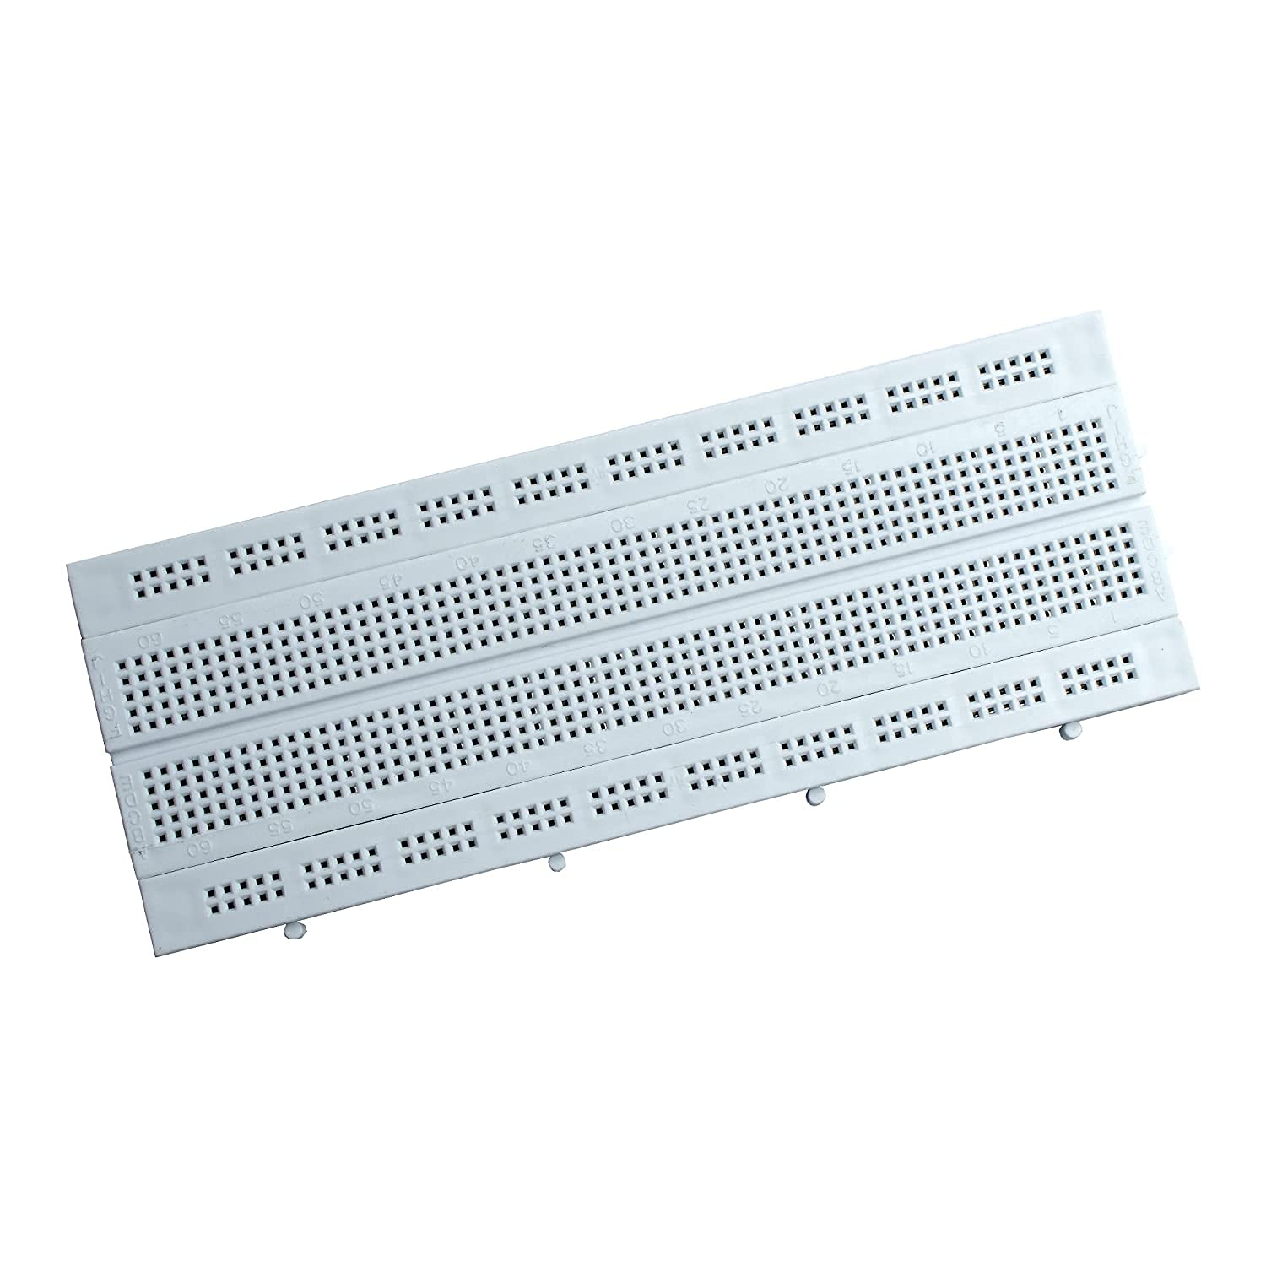
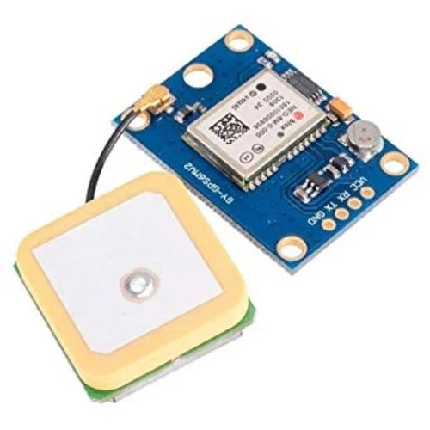
5. GPS Module 6. Breadboard

Slide 12
Software Specification
Front end - Bootstrap Framework
Backend - MySQL
Programming Language - PHP, Arduino
Operating System - Windows 10 or Any Compatible
Editor - Notepad++
IDE - Arduino, Android studio 3.5

Slide 13
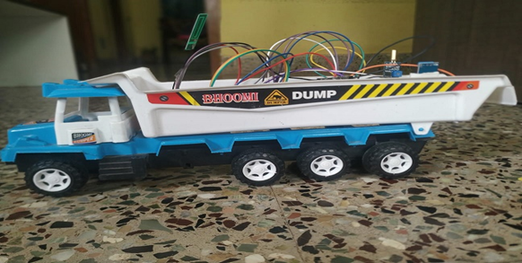
Practical Result :

Slide 14
Expected outcome of the project :
The prototype should detect the accidents as and when occurred with the help of sensors
Using LoRa packets information should be sent
GEO location should be fetched using GPS module
Information of accident must be uploaded to remote server
Alert notification should be sent to mobiles

Slide 15


